Slide 1





RetailFlow Management System
Presented by Cyusa Divince
ID : 27516

Slide 2
PROBLEM STATEMENT
The rapid growth of online shopping has created a need for efficient e-commerce platforms that can manage product listings, customer orders, and payment processing. Many small to medium-sized businesses struggle to establish a robust online presence due to the complexity of managing these components effectively. This project aims to develop a PL/SQL-based Oracle database solution to streamline the e-commerce process, ensuring a seamless shopping experience for customers and efficient management for businesses.

Slide 3
OBJECTIVES
01
Design a relational schema for product ordering, customer data, and transactions
02
Automate order placement using stored procedures
03
Calculate customer spending using functions
04
Prevent stock edits on weekends/holidays with triggers
05
Ensure accountability using audit logs

Slide 4
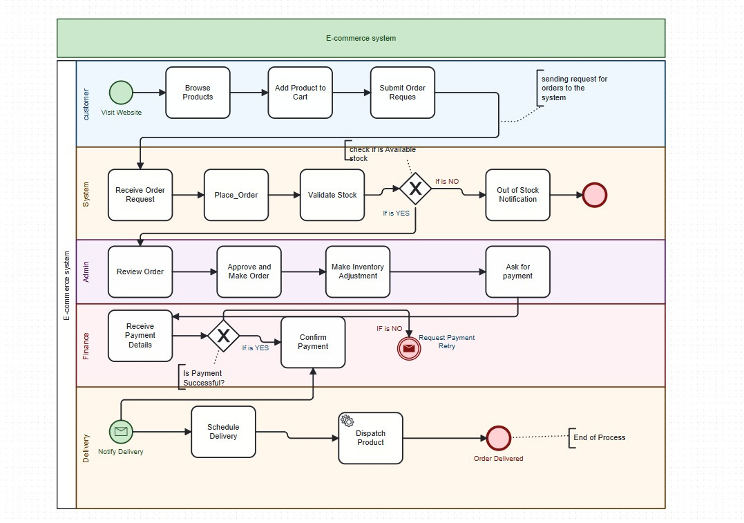
SYSTEM WORKFLOW (BPMN OVERVIEW)
Actors: Customer, System, Admin, Finance, Delivery, Audit Log
Steps:
  Customer browses and places order
  System checks stock, creates order and items
  Admin reviews and confirms
  Finance validates payment
  Delivery dispatches order
  Audit trigger logs restricted actions

Slide 5
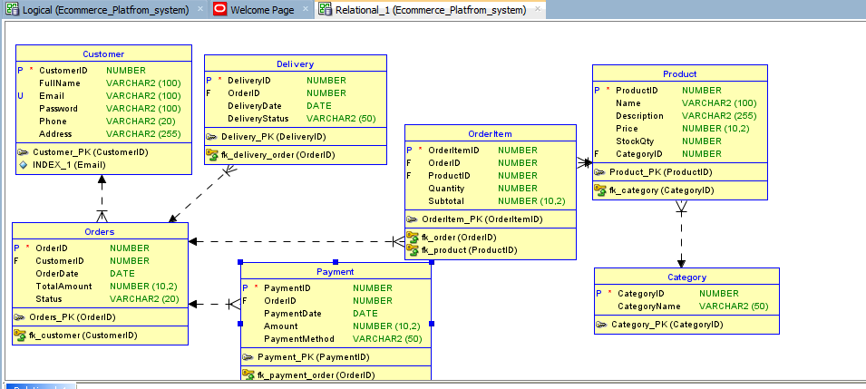
DATABASE DESIGN (ERD SUMMARY)
Entities: Customer, Product, Category, Orders, OrderItem, Payment, Delivery, Holiday, Audit_Log
Key Relationships:
  Customer → Orders
  Orders → OrderItem → Product
  Orders → Payment → Delivery
  Holiday → Audit_Trigger

Slide 6
PL/SQL OBJECTS IMPLEMENTED
  Procedure: Place_Order
  Function: Get_Total_Spent_By_Customer
  Cursor: Get_Pending_Orders using REF CURSOR
  Trigger: Prevents Product DML on weekdays and Public holidays
  Audit Table: Logs restricted activity
  Package: ecommerce_pkg groups all logic including functions and procedure

Slide 7
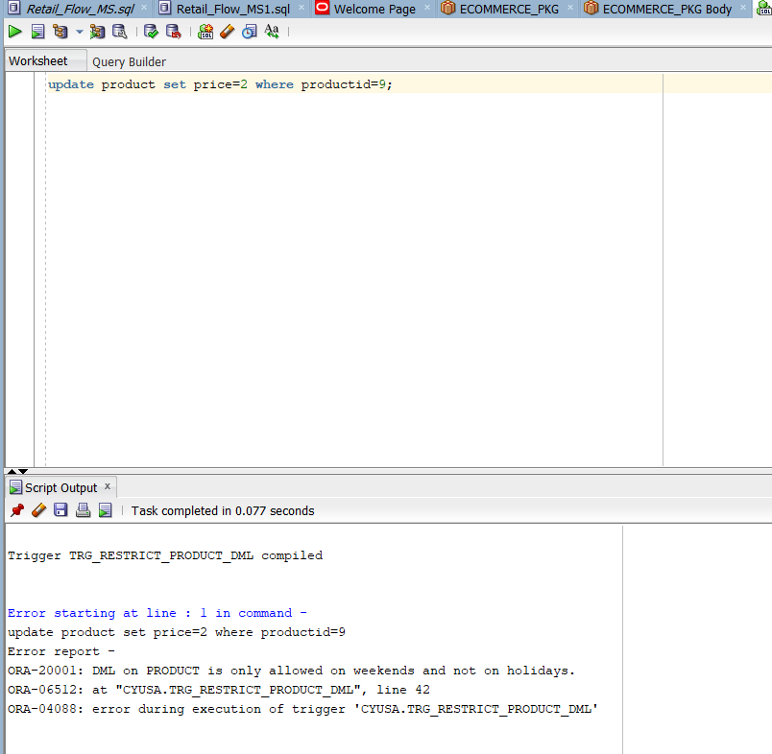
BUSINESS RULE ENFORCEMENT
TRIGGER: TRG_RESTRICT_PRODUCT_DML
  Restricts product modifications:
    Blocks DML on weekdays
    Blocks DML on holidays (checks Holiday table)
  Logs attempts in Audit_Log

Slide 8
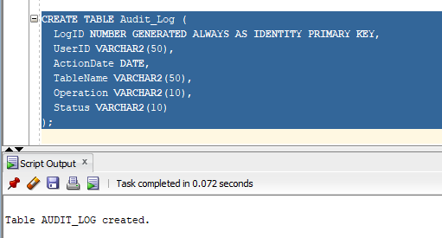
AUDIT LOGGING SYSTEM
SECURITY & COMPLIANCE
  Audit_Log tracks:
  User ID
  Timestamp
  Table affected
  Operation type (INSERT/UPDATE/DELETE)
  Status (Allowed/Denied)

Slide 9
KEY STRENGTHS
01
02
03
Modular PL/SQL package architecture
Transaction safety (COMMIT/ROLLBACK)
Real-world business rules
04
05
Comprehensive audit trail
Sample queries for testing

Slide 10
FUTURE ENHANCEMENTS & CONCLUSION
ENHANCEMENTS:
  Inventory validation
  Shipping cost calculator
  Sales analytics functions
THANK YOU

